Slide 1
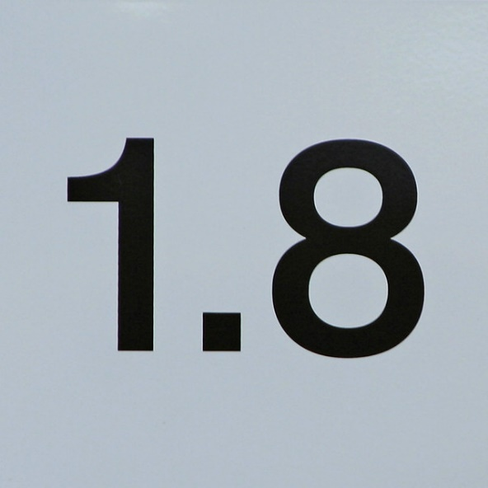
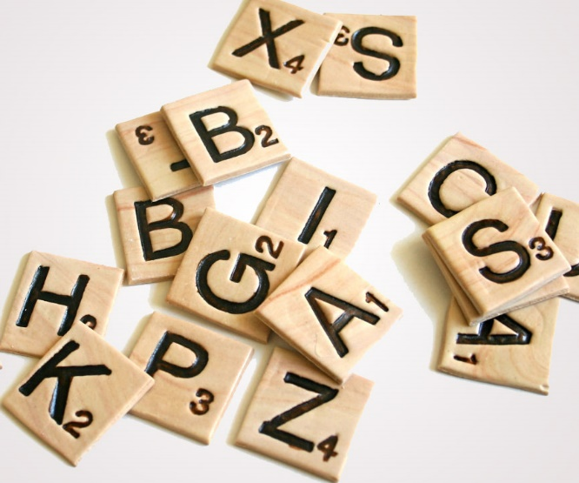


Java Data & Data types
By: Johnny Perez

Slide 2
What is data?
Data is a collection of facts, such as numbers, words, measurements, or observations that carry information.
In programming, data is measured, collected and reported.
When programming in object oriented languages like Java, we must specify the data type of our variables, methods, etc…

Slide 3
Primitive vs Objects
In order to begin learning about the different data types, we must start learning the hierarchy of data in the Java programming language
Java Data is divided by Primitives and Objects
Primitive data types are forms of data that only specify the size and type of the variable values
Objects (also called reference types) are forms of data that contain additional values and usually reference one or more data types.

Slide 4
What are the primitive data types?
byte = numbers from -128 to 127
Short = numbers from -32,768 to 32,767
Int = numbers from –2,147,483,648 to 2,147,483,647
Float = stores fractional numbers up to 7 decimal places
Double = stores fractional numbers up to 15 decimal places
Boolean = store true or false
Char = store single characters or ASCII values

Slide 5
What are the Objects?
Safe to say that it be impossible to mention all the objects in the Java Library
Also it is difficult to say all of them as we can create or own objects
Objects contain methods usually unique to its type that help us process the data inside of it.
The most common objects in the Java Library are:
Numbers = A reference to all numbers
Strings = a collection of chars
Arrays = a immutable collection of other data
ArrayList = a mutable collection of data

Slide 6
How do we declare variables with a data type?
The common syntax for declaring variables in Java is
datatype variable_name = data;
OR
datatype variable_name;
Example:
A Primitive: int num1 = 10;
A Object: String str1 = “Hello World”;

Slide 7
What can we do with data?
We can perform operations on variables that coincide with they’re types
Examples:
We can add numbers
We can join strings
We can store collections of data
We can check for equality

Slide 8
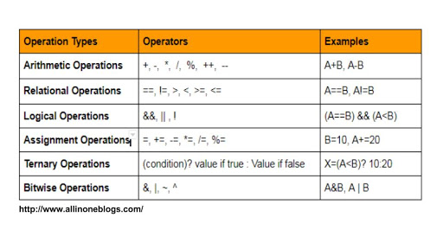
Operators
Operators are used to perform operations on variables and values

Slide 9
Lets try some operations
int num1 = 10;
int num2 = 7;
System.out.println(num1 + num2);
Prints out 17
System.out.println(num1 == num2);
Prints out False
System.out.println(num1 * num2);
Print out 70

Slide 10
Try some operations yourself
Make a variable that calculates the area of a triangle
Make a variable that calculates the percent out a fraction
Example:
90/100 = 100%
33/55 = 66%
4/5 = 80%
Combine two Strings
Example
“Hello” and “ World” = “Hello World”

